Slide 1
Dunkin Brands Valuation
Rebecca Sanders, Nathan Stadheim, John Markwiese, Tong Chen, Jiashuo Zhang, and Mohammed Hardan

Slide 2
Target
Company
Dunkin Brand Group Inc. franchises quick service restaurants serving hot and cold coffee and baked goods as well as ice cream.
Leading multi-concept quick-service restaurant franchisor that operates both the Dunkin’ Donuts and Baskin-Robbins chains here in the U.S. and around the World.
Company went public on July 2011 and trades on Nasdaq

Slide 3
Current Events
Panera Bread was purchased by JAB Holdings (Barron’s -April 8 edition).
The Panera takeover was the third such deal in just 45 days, following Darden’s (DRI) purchase of Cheddar’s Sandwich Kitchen and Restaurant Brands Internationals (QSR) take out of popeyes Louisiana Chicken. In the immediate aftermath of the Panera deal Dunkin, which was rumored to be a potential target of JAB, traded off 3%.
JAB Holdings and Panera Bread Co agreed to merge in a $7.5 billion in which Panera’s shareholders will receive $315 per share in cash.
Dunkin' Brands Announces Dividend Increase in 2017 First Quarter
Dunkin' Brands Group, Inc. to Announce First Quarter 2017 Results
Dunkin’ Brands announced CFO leadership transition--Paul Carbone, Dunkin’ Brands CFO is leaving the company effective April 21, 2017 for a general management position in the specialty retail industry, where he worked prior to Dunkin’ Brands. Dunkin’ Brands vice president, finance and treasurer, has been appointed to serve as interim CFO upon his departure.

Slide 4
Comparable Companies Benchmark/Valuation Numbers
 | DNKN | MCD | SBUX | PZZA | SONC | CMG
Debt/Tot. Cap | 107% | 107% | 35% | 109% |  | 0%
Debt/EBITDA | 5.4x | 2.8x | 0.7x | 1.7x | 0.9x | 0.0x
Net Debt/EBITDA | 4.8x | 2.6x | 0.2x | 1.6x | 2.2x | 0.0x
P/E | 39.74 | 21.84 | 29.22 | 20.55 | 34.47 | 166.95
ROA | 6% | 2% | 21.05% | 20.44% | 10.01% | 2%
ROE | 7.61% | 14.18% | 48.16% | 316.98% | N/A | 1.30%
EV/EBITDA | 18.1x | 15.1x | 17.1x | 19.7x | 79.2x | 15.2x
Notes:
ROA #’s, and EV/EBITDA from: http://www.marketwatch.com/investing/stock/SONC/profile
ROE is from Yahoo Finance

Slide 5
Comparable Companies - Benchmarks/Valuation
Based on the Dunkin’s numbers compared to those of the industry, Dunkin should be traded at a discount
Higher leverage than competitors
Lower ROA
Lower ROE
Trades at premium P/E
We used the EV/EBITDA multiple to value Dunkin’ because EV/EBITDA is independent of the capital structure since high level debt doesn't affect the company’s valuation
Could argue for a lower valuation suppose to higher vs. competitors

Slide 6
Precedent Transactions Analysis
Notes:
EV/EBITA= 17.9 (avg. excluding Boston chicken deal)
Dunkins EV= $7,879,383,100

Slide 7
Discounted Cash Flow
Drop in Gross Profit, EBIT, and EBITDA from 2016-2017
Increase in projected Sales and COGS from 2016-2021

Slide 8
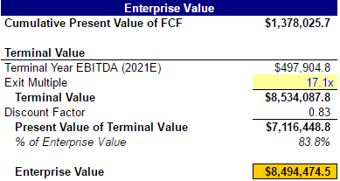
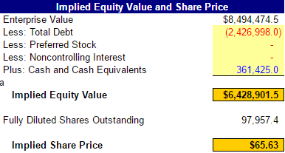
DCF Valuation
Actual Share price: 54.90
Using Market Value
Debt-to-Cap: 28%
Equity-to-Cap 72%
WACC: 3.7%
Re-levered Beta: 0.79
Interest Coverage Ratio Strong
Will be able to pay off interest on debts
EBIT/Interest Expense 2014-17
Ranges: 4.23-5.29
Notes:
Used market value instead of book value because of negative shareholders equity

Slide 9
End Valuation
Comparable Analysis Enterprise Value = $8,005,380,000
Precedent Transaction Enterprise Value = $7,879,383,100
Discounted Cash Flow Enterprise Value = $8,494,474,500
Average Enterprise Value = $8,126,412,530
Implied Price per Share = $67.02

